Slide 1

MULTIPROGRAMMED SERVER Performance Evaluation of Computer System and Networks
Califano Tommaso • Ramacciotti Nicola • Suma Gabriele
Master degree in Computer Engineering, 1st year
Year 2023/24, fall term

Slide 2
Table of contents
01
02
03
04
05
Overview
Model
Implementation
Objectives and key performance indexes
Thereotical model, assumptions and factors
Omnet++ model and verification tests
Data Analysis
Conclusion
Calibration and simulations scenarios

Slide 3
01
Overview

Slide 4
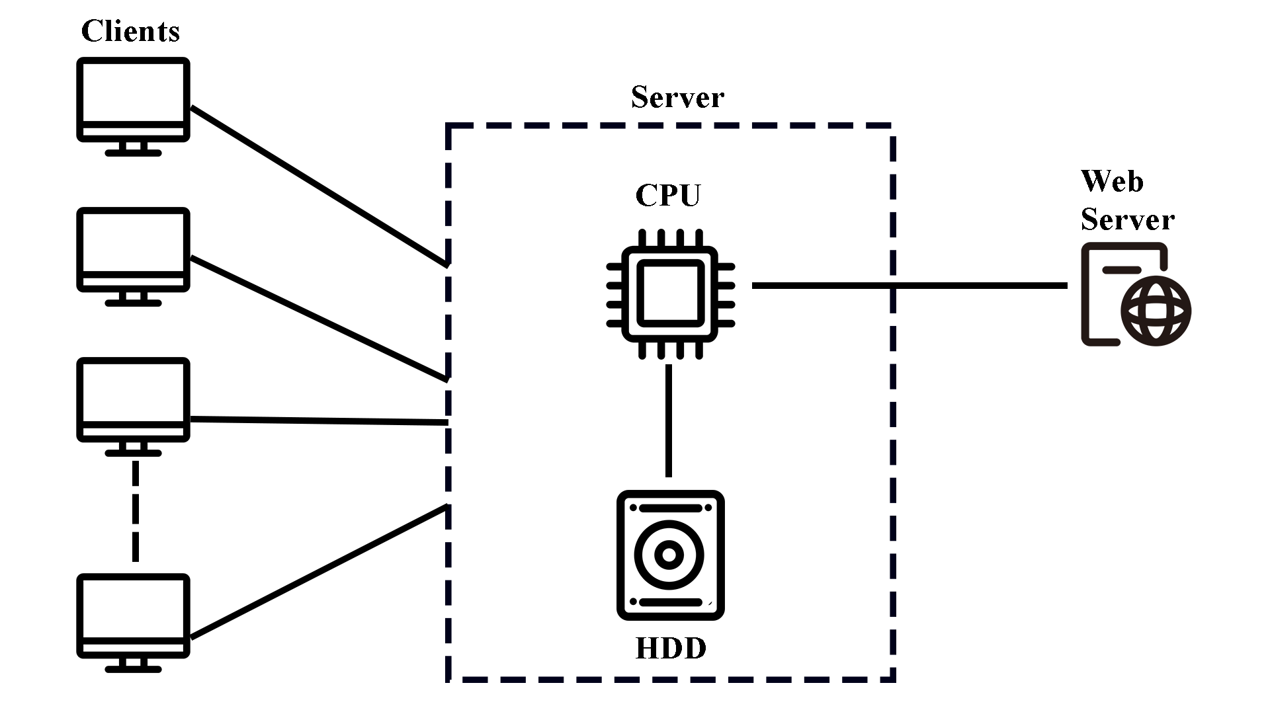
Overview
Objectives:
Throughput
Utilization
Key performance indexes:
Throughput: the number of completed transactions per unit of time.
Utilization: the time percentage during which each node is busy.

Slide 5
02
Model

Slide 6
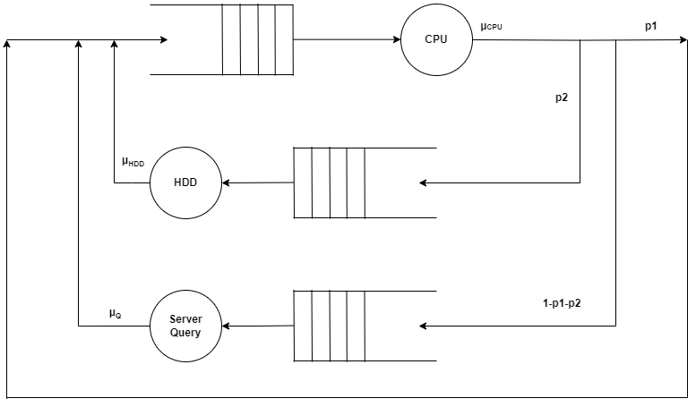
Model
Assumptions
Finite number of clients = Number of jobs within the system.
Infinite queue size
Service centers: exponential distributed service time with a different rate and FIFO order processing.
p2
µHDD
Factors
N
µCPU
p1
µQ

Slide 7
03
Implementation

Slide 8
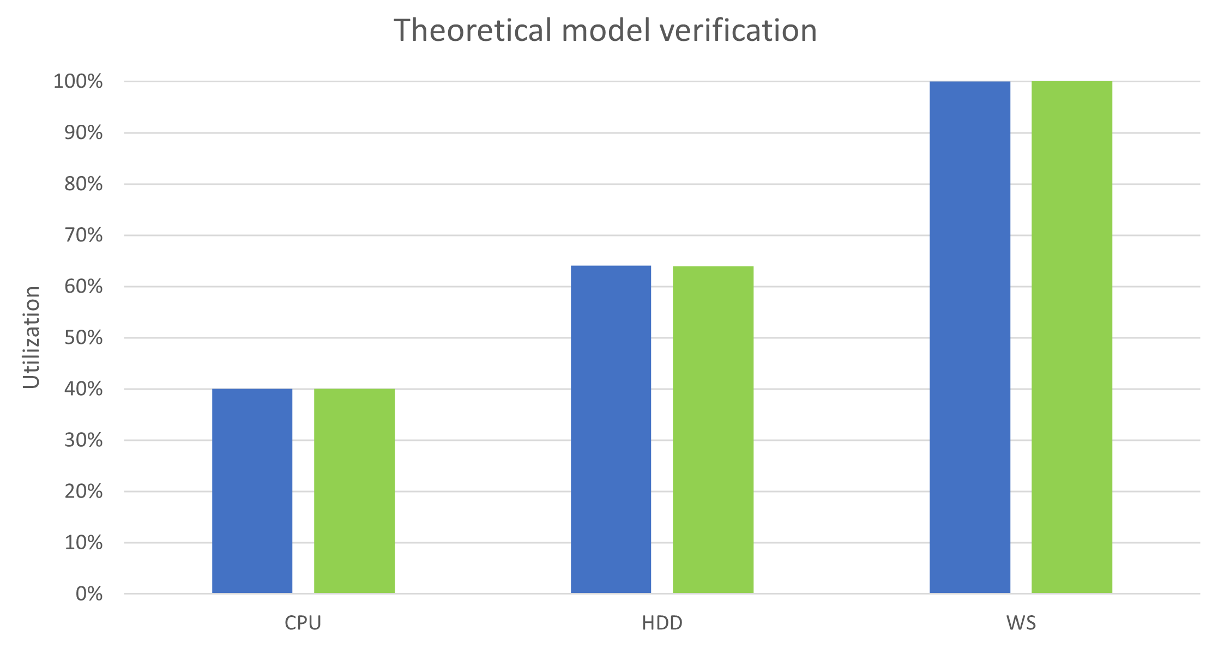
Omnet++ Model
Server
Client
CPU
HDD
Empirical utilization
Web Server
Theoretical utilization

Slide 9
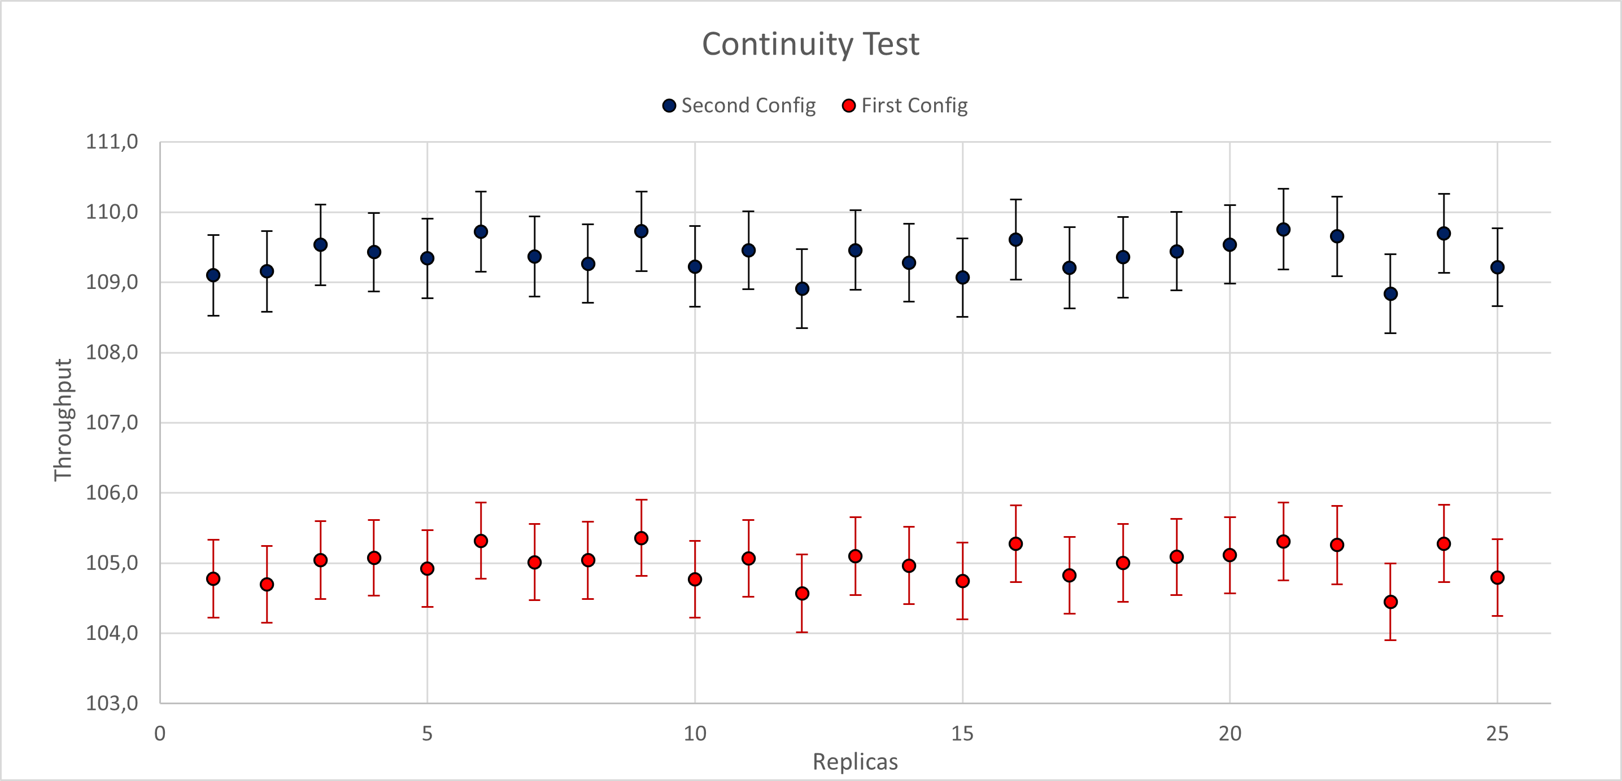
Verification
Continuity Test
Second Config
p1 = 0.35 | µCPU = 1000
p2 = 0.41 | µHDD = 250
 | µQ = 75
Number of clients = 40
First Config
p1 = 0.35 | µCPU = 1000
p2 = 0.40 | µHDD = 250
 | µQ = 75
Number of clients = 40
Confidece level: 95%

Slide 10
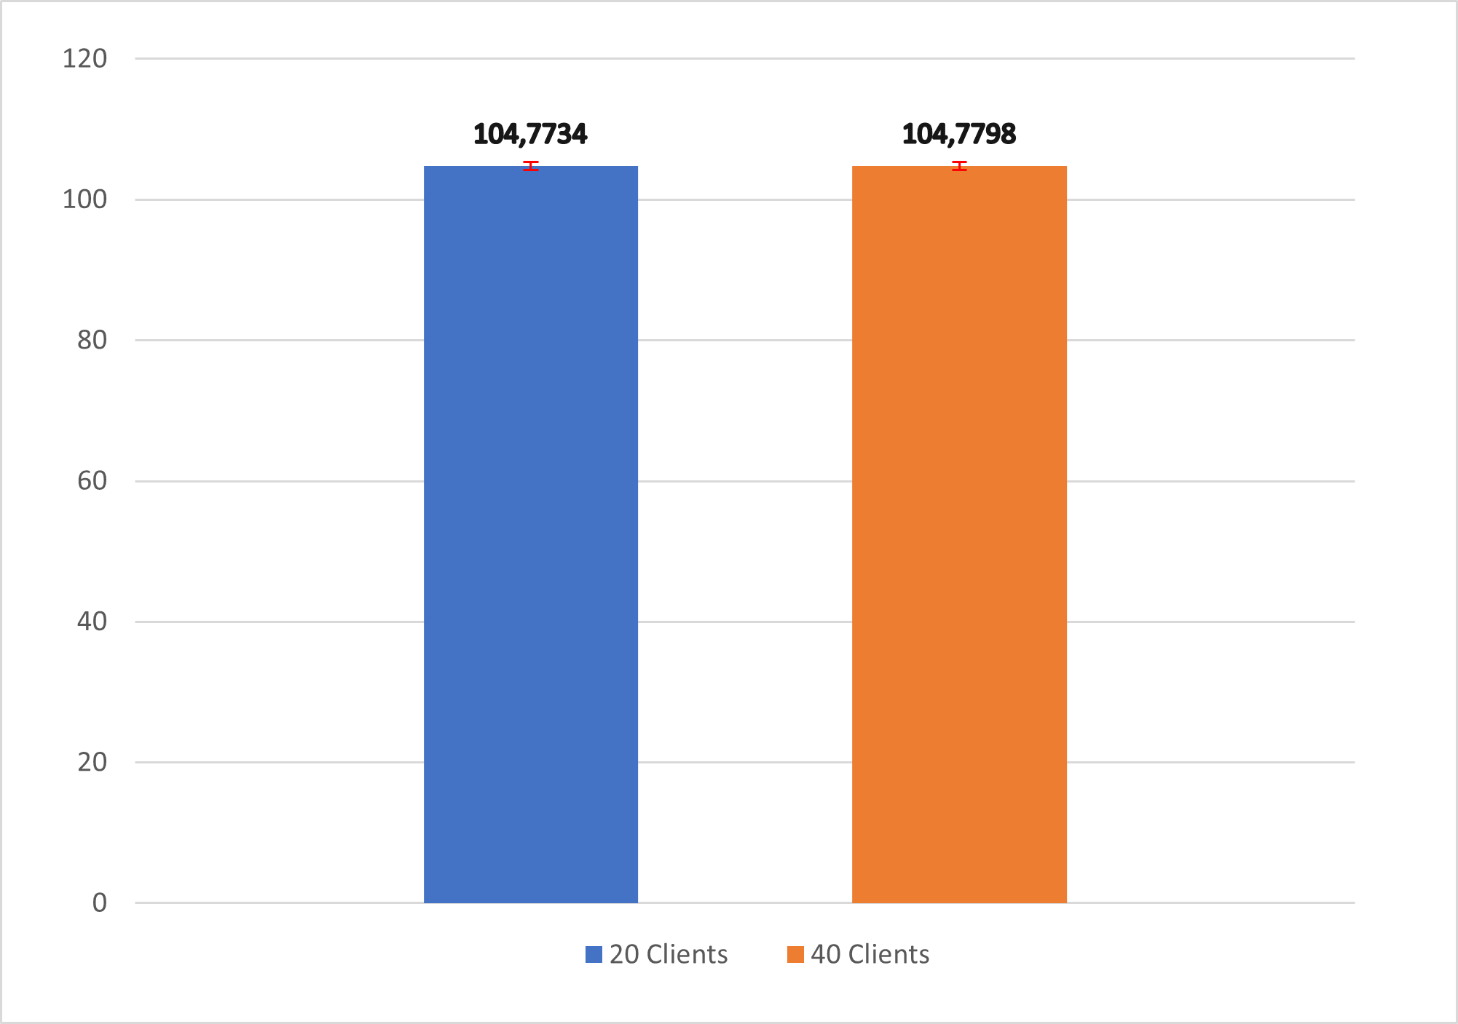
Verification
Consistency Test
Common Values
p1 = 0.35 | µCPU = 1000
p2 = 0.40 | µHDD = 250
 | µQ = 75
20 Clients
40 Clients
Confidece level: 95%

Slide 11
04
Data Analysis

Slide 12
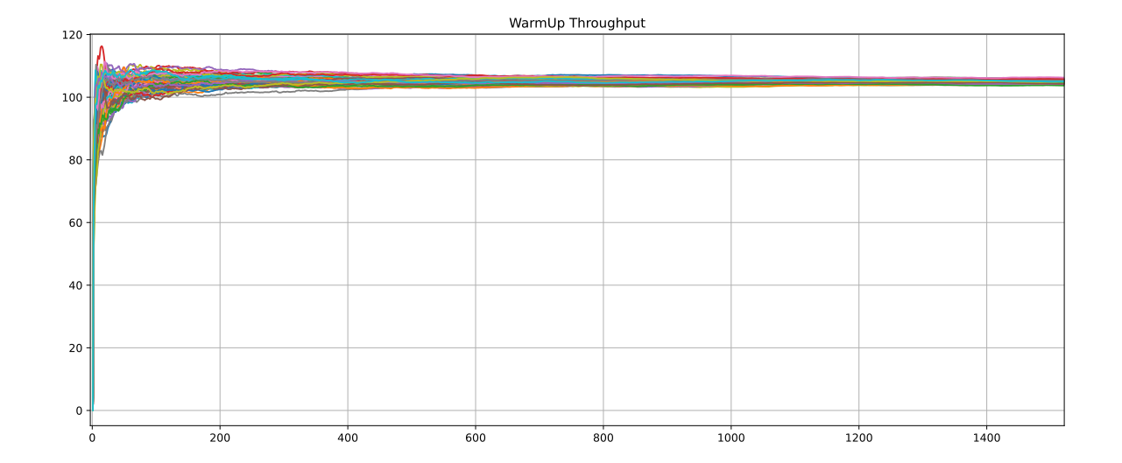
Calibration
Warmup evaluation
Repetitions
The experiment was based on 100 repetitions
Gathered data
All data were analyzed with time average function
Final Value
We choosed 500s

Slide 13
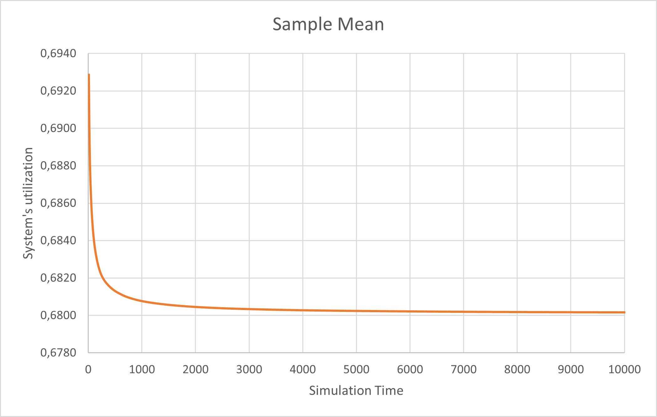
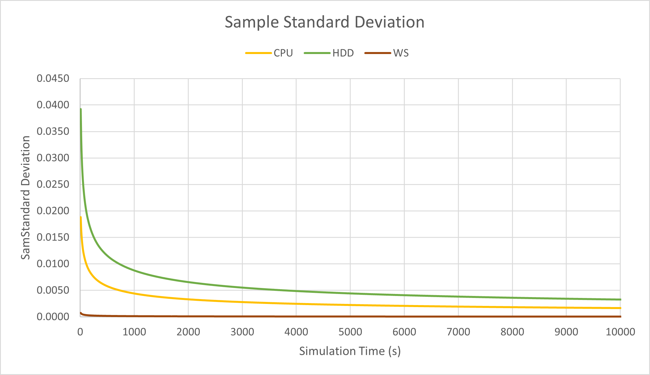
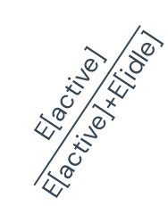
Calibration
Simulation Time
Repetitions
Theoretical Verification
Final Value
500 repetitions
Sample mean & Sample Standard Deviation
We choosed 4000s
Gathered Data
The sample mean converge to
$$\frac{\text{E}\text{[}\text{active}\text{]}}{\text{E}\text{[}\text{active}\text{]+}\text{E}\text{[}\text{idle}\text{]}}$$

Slide 14
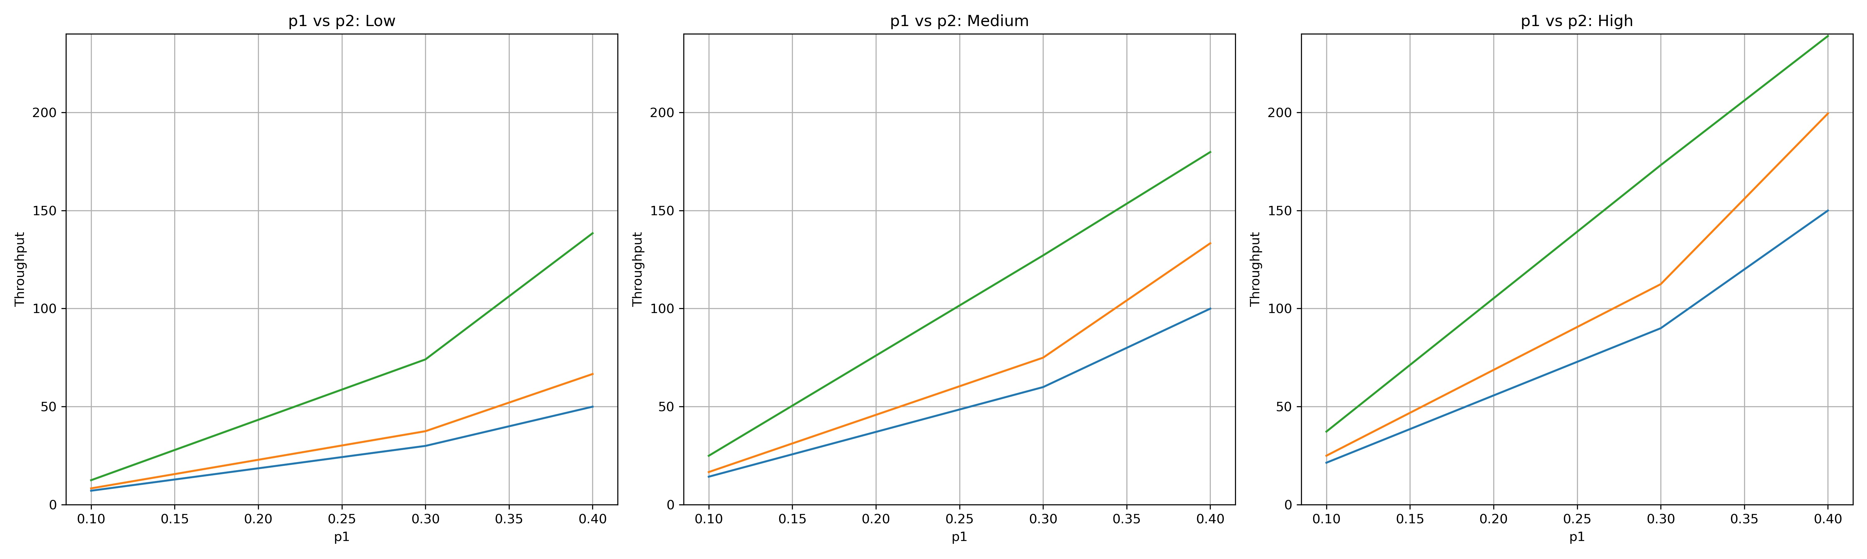
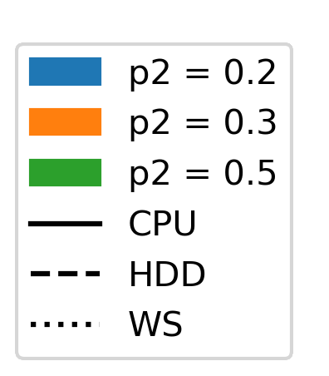
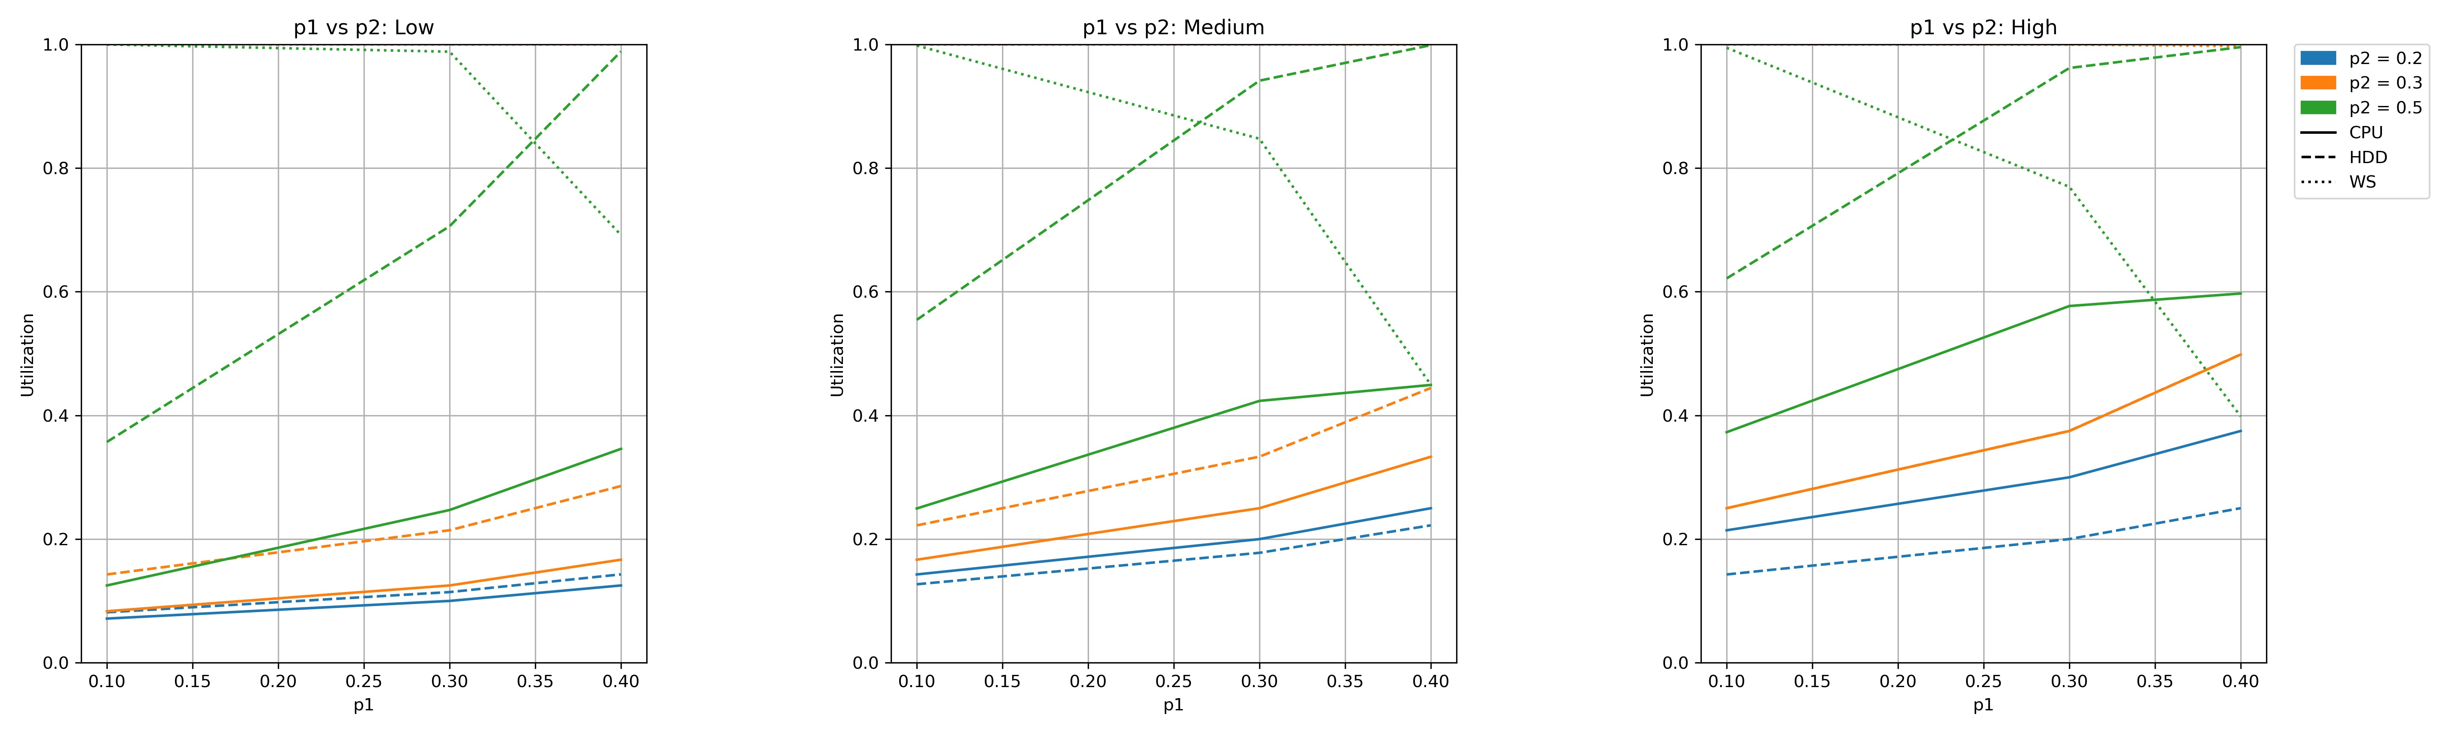
Simulation Scenarios: p1 vs p2
Low
Medium
High

Slide 15
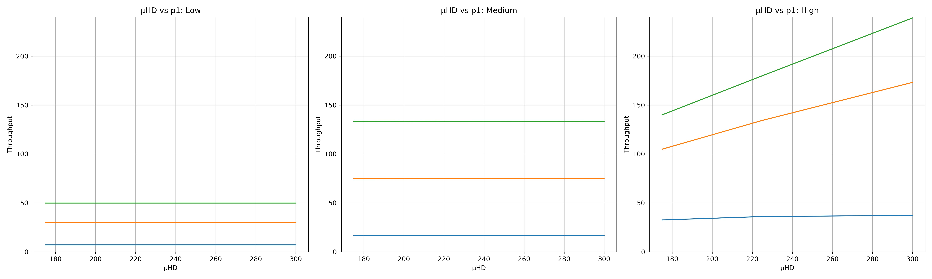
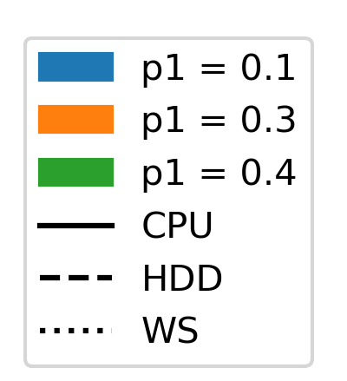
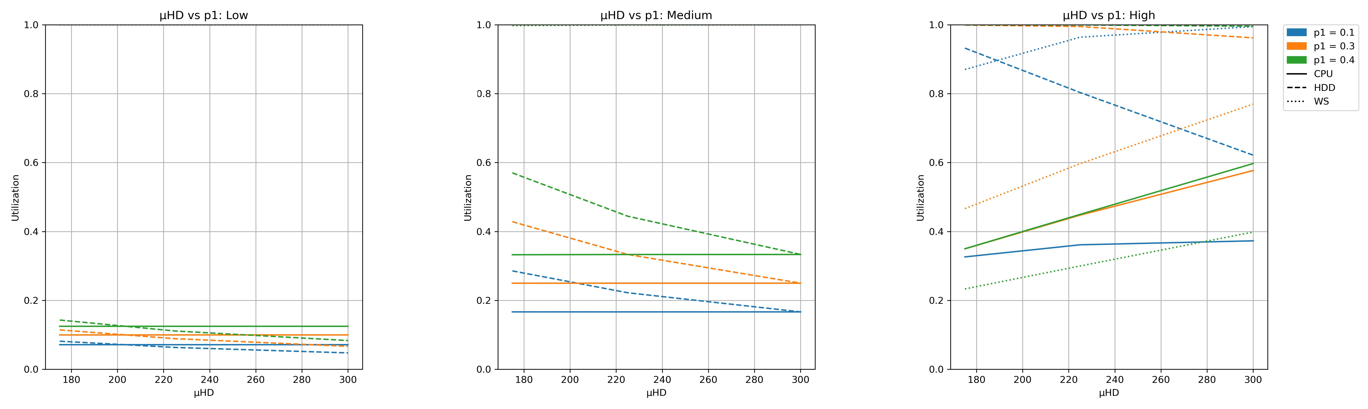
Simulation Scenarios: µHDD and p1
Low
Medium
High

Slide 16
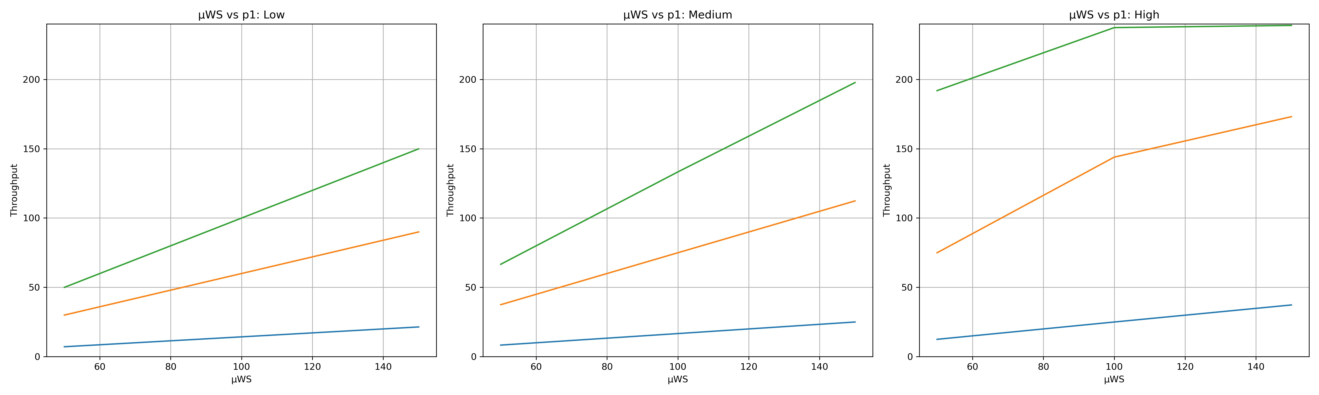
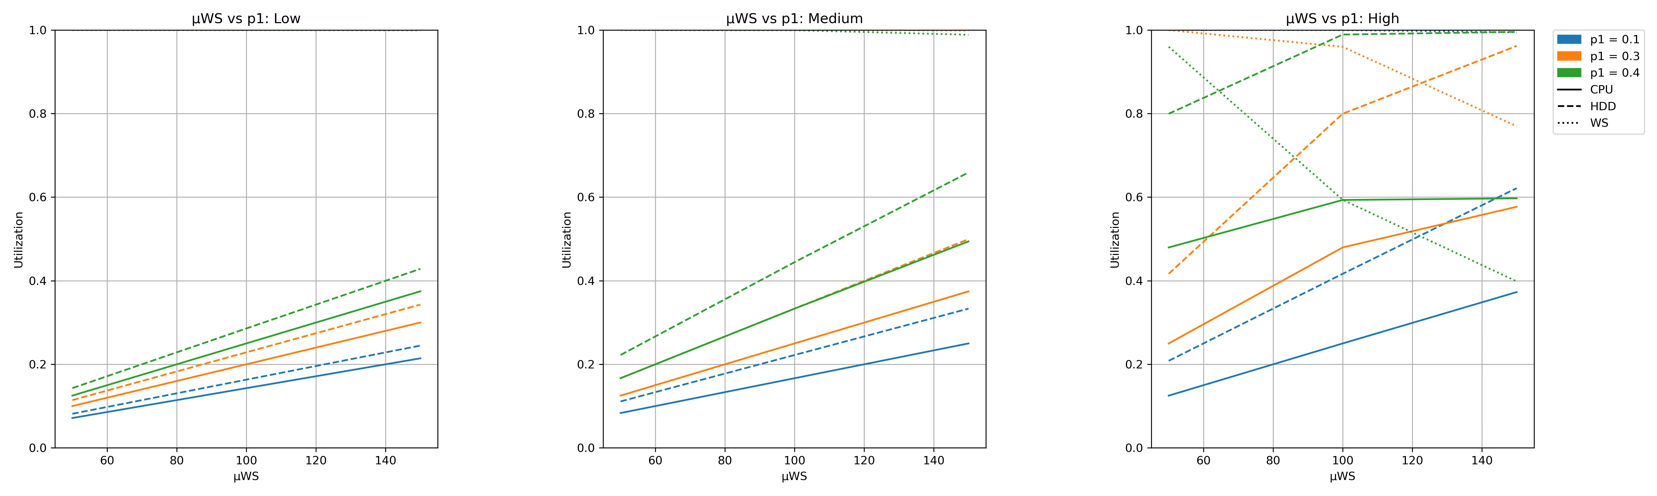
Simulation Scenarios: µWS and p1
Low
Medium
High

Slide 17
05
Conclusion

Slide 18
Conclusion

Slide 19
Thanks!

